Slide 1
Sprint 1 Presentation
Guided By : Vikas Verma
Present By: Akshay Patil

Slide 2
Ecommerce Web Api using Asp.net & Angular

Slide 3
LANGUAGES:
HTML5
CSS3
Bootstrap
My Sql
Tools:
Microsoft sql server
Visual Studio 2019
Visual Studio Code

Slide 4
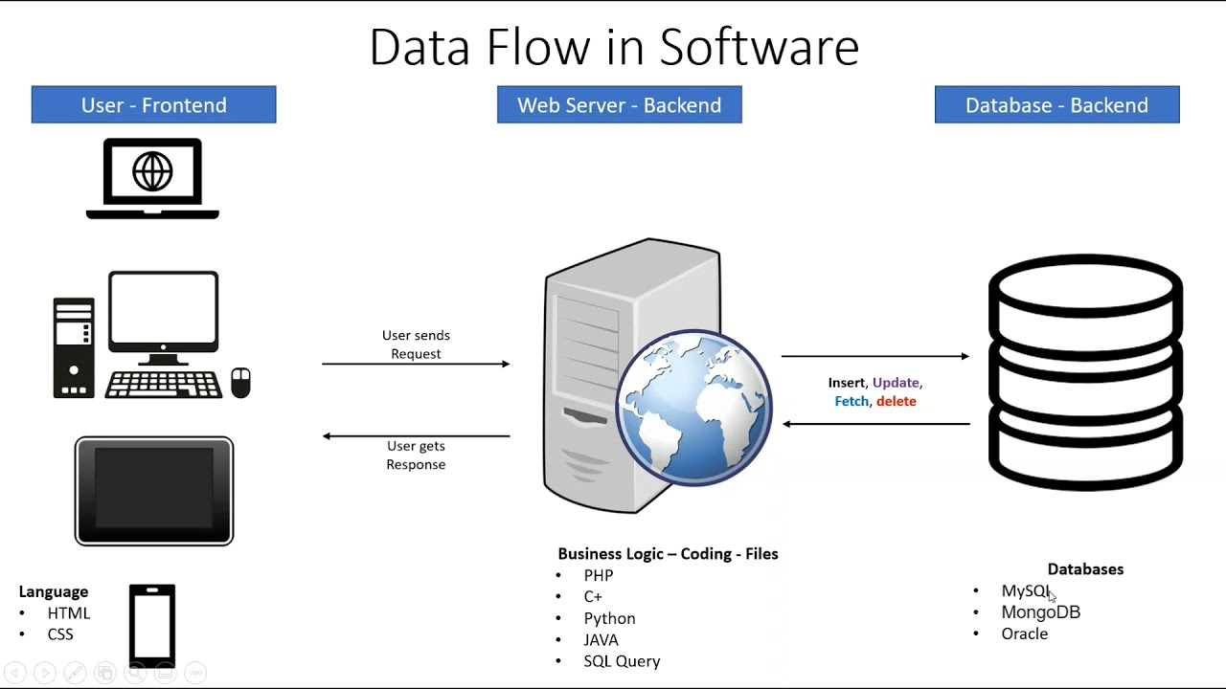

Slide 5
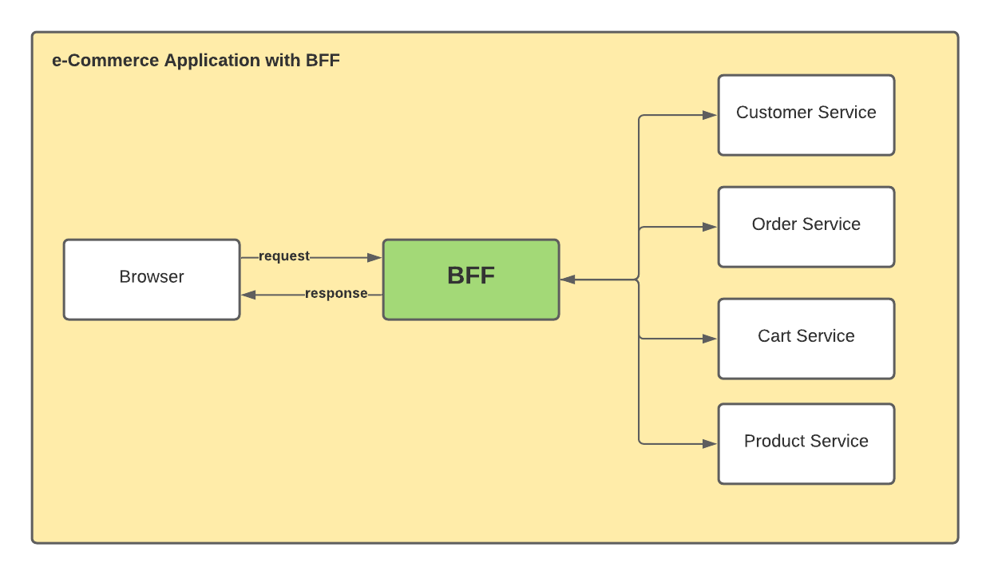
Backend Frontend Flow

Slide 6
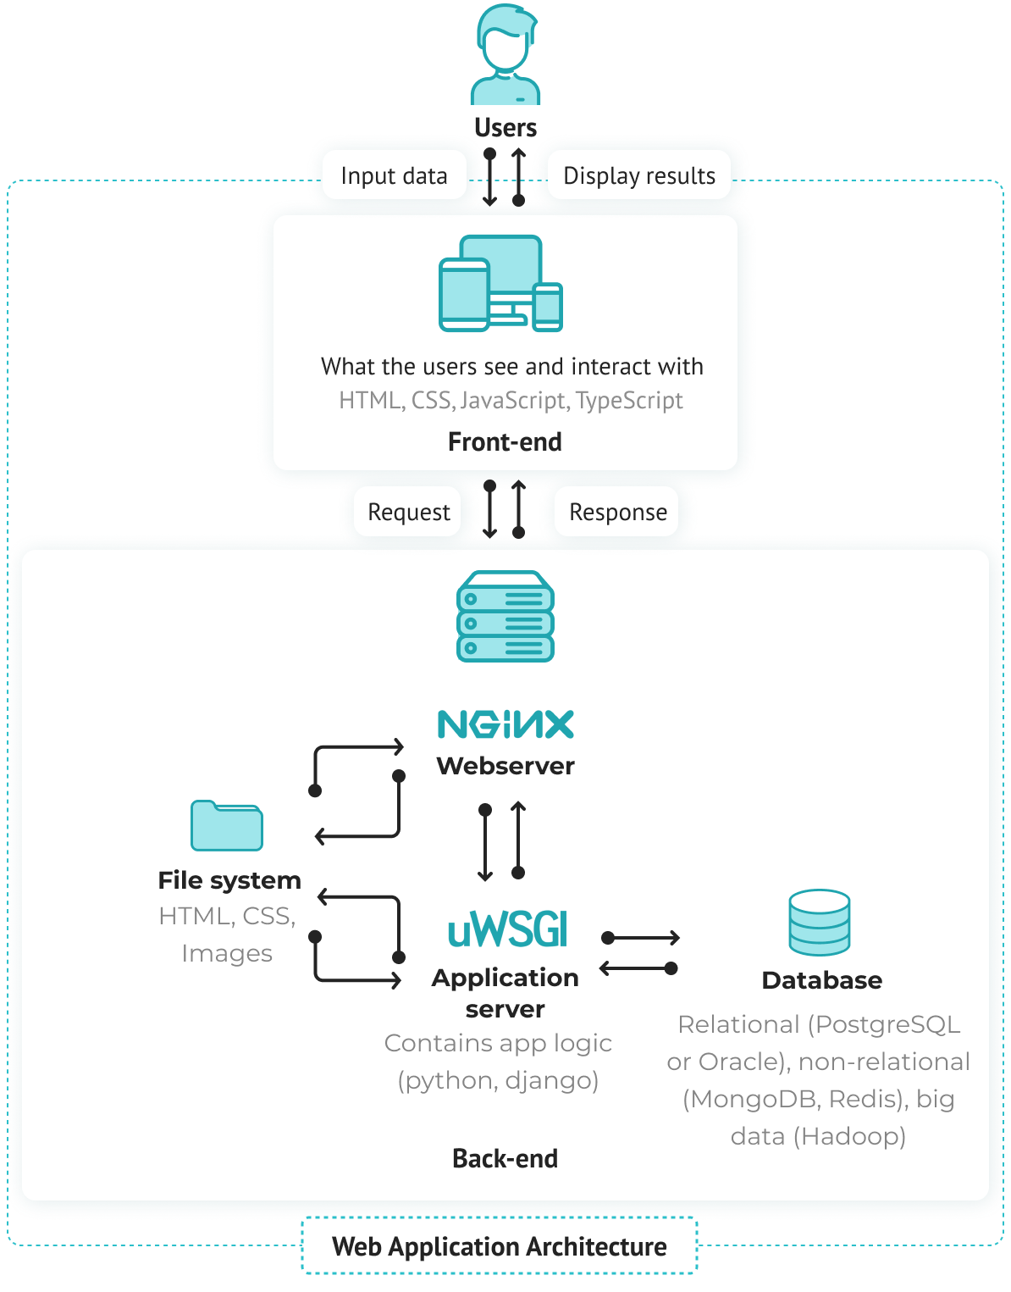

Slide 7
Methods:
Creation of ASP. Net core web API
Implementation of Controllers & Models for Backend
SQL query commands for storing the data into database
Implementation of Angular for the e-commerce application
Implementation of Login & Register part
Implementation of Authentication part for user and admin
Implementation of add products & edit products for the admin
Implementation of add to cart for the user

Slide 8
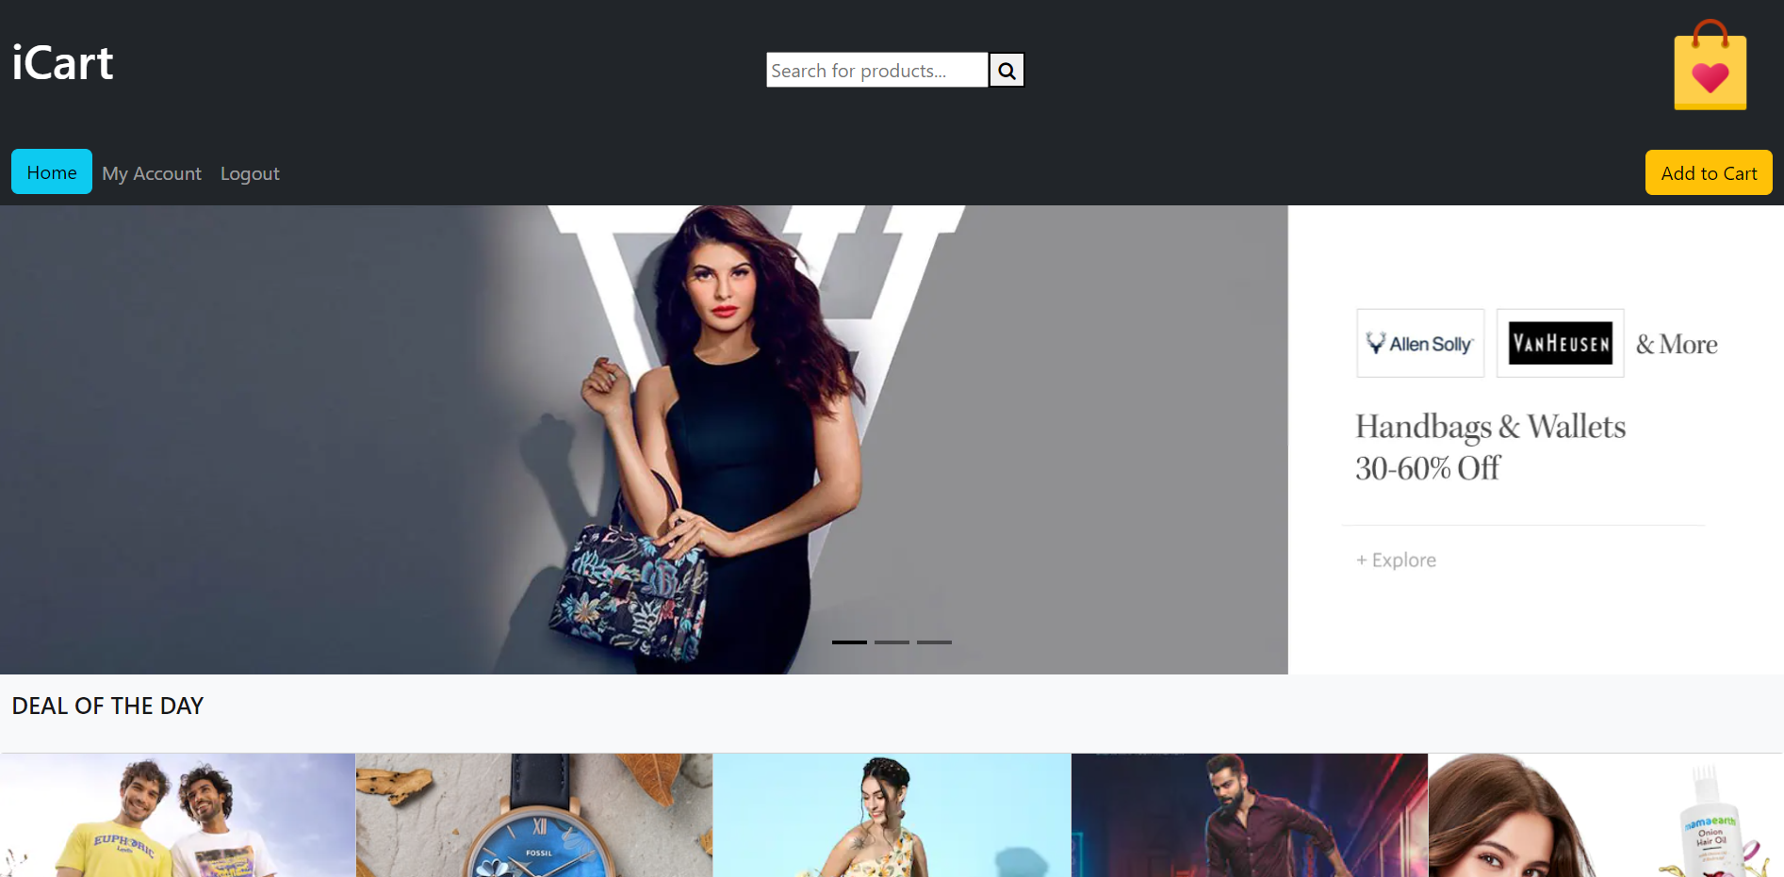
HOME PAGE

Slide 9
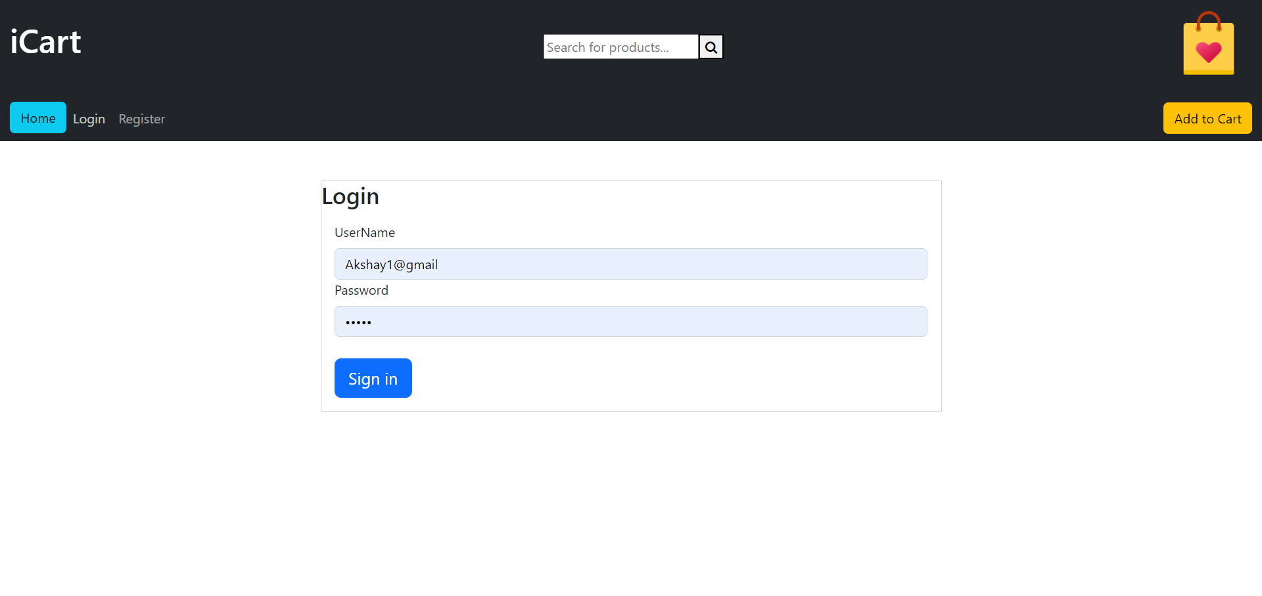
LOGIN PAGE

Slide 10
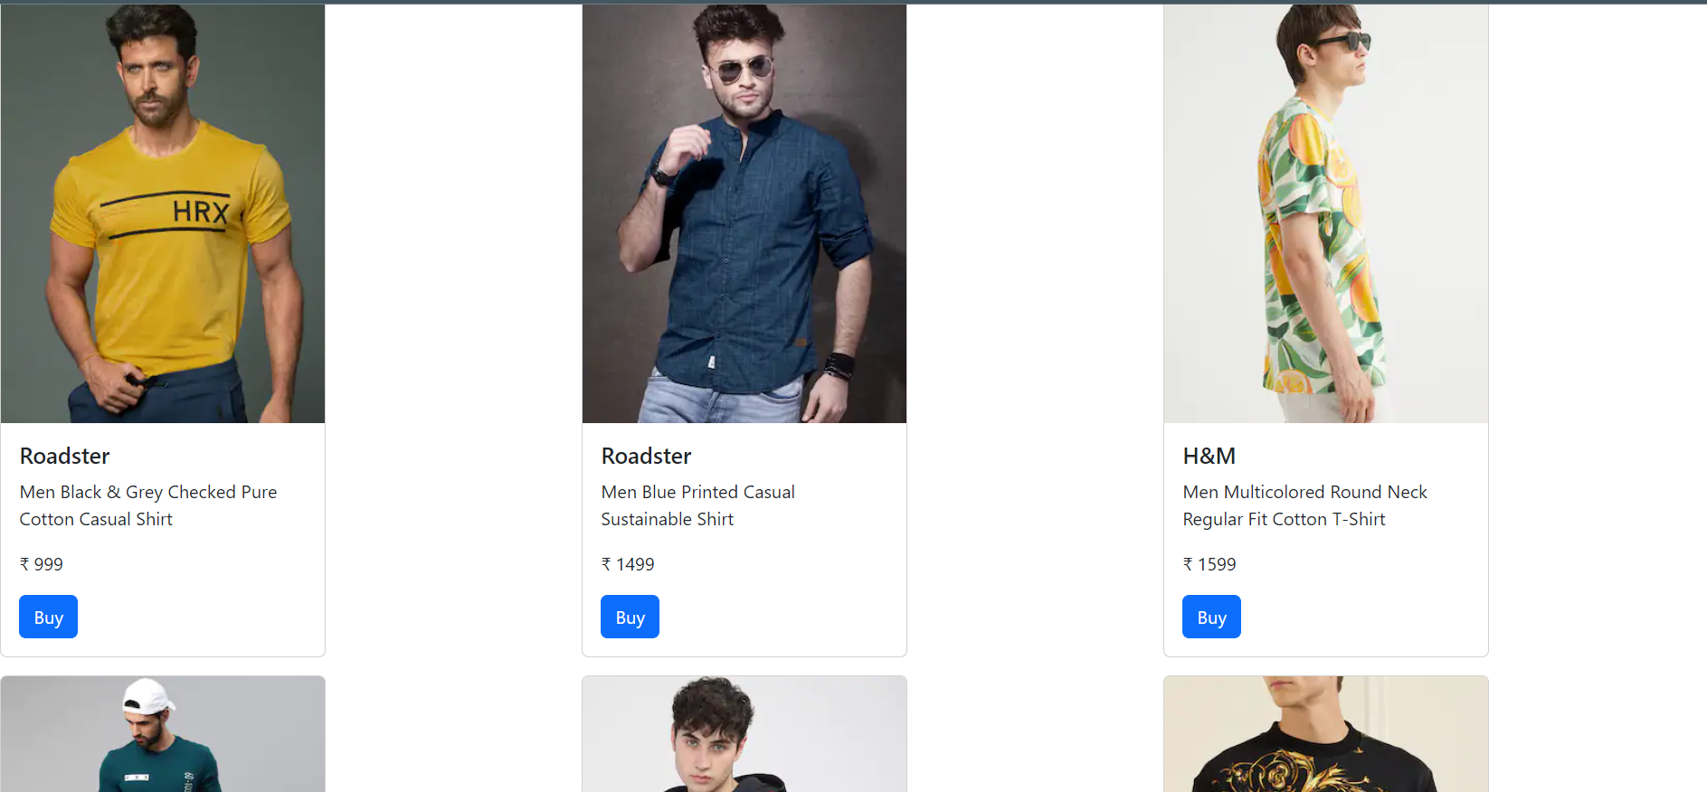
Products

Slide 11
THANK YOU

